Slide 1
Question Bank for Slip Test-1
UNIT – I:
1. Define design thinking.
2. What is meant by thinking and behaviour?
3. List the types of thinking.
4. What is linear thinking?
5. What is lateral thinking?
6. Mention two impacts of science and engineering on society.
7. What is the importance of design thinking?
8. What is meant by a human-centric approach in design thinking?
9. List the five stages of the design thinking process.
10. Why is the design thinking process called iterative?
11. Mention two applications of design thinking in real life domains.

Slide 2
Question Bank for Slip Test-1
UNIT – II:
1. What is meant by the empathize phase in design thinking?
2. Why is understanding user needs important in design thinking?
3. What is meant by empathy towards users?
4. List steps involved in the empathize phase.
5. What is a beginner’s mindset in design thinking?
6. What is an immersion activity in design thinking?
7. Mention steps in immersion activity.
8. Define bodystorming.
9. What is the purpose of bodystorming in design thinking?
10. How does empathy help in problem identification?

Slide 3
Question Bank for Slip Test-1
Unit-3:
1. What is the Define phase in the Design Thinking process?
2. Why is the Define phase important in Design Thinking?
3. Define analysis in the Design Thinking process.
4. Define synthesis in Design Thinking.
5. What is the difference between analysis and synthesis?
6. What is an Empathy Map?
7. List the four components of an Empathy Map.
8. What does “Says” represent in an empathy map?
9. What does “Thinks” represent in an empathy map?
10. What does “Does” represent in an empathy map?

Slide 4
Design Thinking - Unit 3
UNIT – III : Define phase: Define the problem and interpret the result, analysis and synthesis, Personas – Four different perspectives on Personas, steps to creating personas, problem statement, affinity diagrams, empathy mapping.

Slide 5
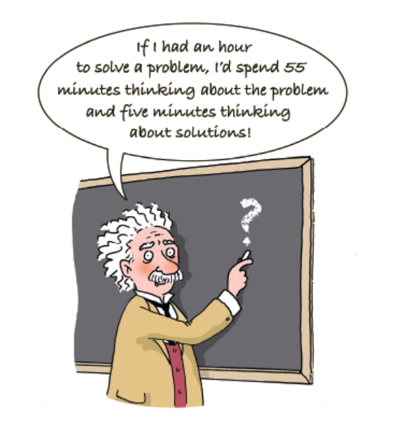
Einstein’s words emphasise the importance of defining a problem clearly in order to solve it.
The more time we devote for perfecting the wording of the problem, the closer we will be to the solution.

Slide 6
Define Stage
Define is the convergent phase where we make informed decisions from the insights gained from Empathize.
In the define phase, design Thinkers will analyse the observations and synthesise them so as to define the core problems that have been identified up to this point, from the first stage (Empathise phase).
The Define stage of Design Thinking first identifies the problem designers are trying to solve to keep everyone oriented to the same solution.
The main goal is to define a meaningful and actionable problem statement.
A precise definition of the problem statement will guide team and team’s work and kick-start the ideation process in the right direction.
It will invite clarity and focus into the design space.
On the contrary, if enough attention is not paid to define stage, team will work like a blind man stumbling in the dark.

Slide 7
Define the problem
The word “Problem” stems from the Greek word “proballein” which means to throw before.
A key approach that you can take when defining your problem is to ask 'why' questions to identify and gain an in-depth understanding of the issue.

Slide 8
Define the problem- Toyota case study
Toyota, known for its efficient manufacturing processes, developed the “Five Whys” technique to refine problem statements and find root causes before jumping to solutions.
Example:- A production line at Toyota was frequently stopping due to a machine malfunction.
Initially, workers described the issue as: “The machine is broken.”
If they had simply replaced the machine or done basic repairs, they might have only solved a surface-level issue.
They applied the Five Whys to Refine the Problem:
1. Why did the machine stop? → Because it overheated.
2. Why did it overheat? → Because the lubricant was not circulating properly.
3. Why was the lubricant not circulating properly? → Because the pump was clogged with metal shavings.
4. Why were there metal shavings in the pump? → Because the filter was not working correctly.
5. Why was the filter not working correctly? → Because it hadn’t been regularly maintained

Slide 9
Define the problem- Toyota case study
Toyota team defined the Problem Statement as:
“The machine is overheating due to a lack of regular filter maintenance, causing production delays.”
Solution:
Instead of just repairing or replacing the machine, Toyota implemented a preventive maintenance schedule to ensure filters were cleaned regularly.
This not only fixed the immediate issue but also prevented future breakdowns, improving overall efficiency.

Slide 10
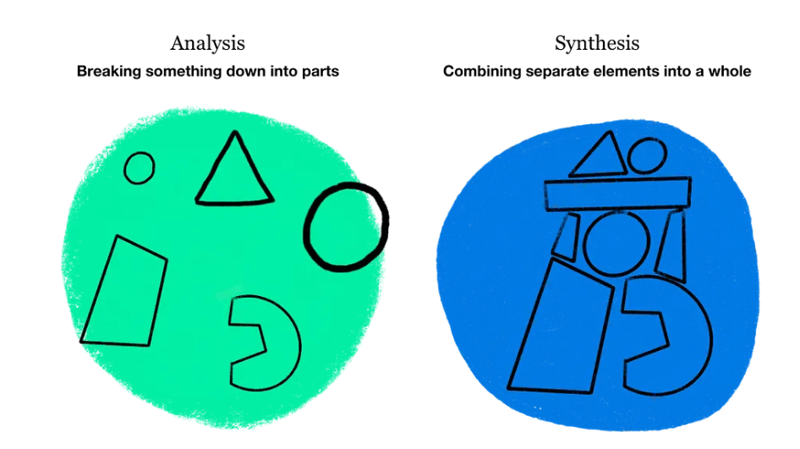
Analysis Vs Synthesis

Slide 11
Analysis and Synthesis
Analysis is defined as the procedure by which we break down an intellectual or substantial whole into parts or components
Synthesis is defined as the opposite procedure: to combine separate elements or components in order to form a coherent whole
Both these words come from Greek, in which analysis means pulling something apart, and synthesis putting something together.
To analyse is to pull something apart: to give insights into the what, why, where, how, and who. To synthesize is to draw on one or more sources and infer relationships among those sources in a new and meaningful way, and from which any reasonable person could make plans or decisions.
Analysis is about breaking something apart and looking at the pieces individually, synthesis is about putting ideas and information together to see an overall pattern how things come together

Slide 12
Examples of Problem Statements after Analysis and Synthesis
1. College Canteen problem
Observations/Pain Points: Long queues, crowd, short lunch break, limited seating.
Problem Statement:
College students need a faster and more efficient canteen service because they have limited lunch break time and face long waiting times.
2. Online Learning
Observations/Pain Points: Students lose concentration, long lectures, lack of interaction.
Problem Statement:
Students need more interactive online learning methods because long lectures reduce attention and engagement

Slide 13
Problem Statement
A problem statement identifies the gap between the current state (i.e. the problem) and the desired state (i.e. the goal) of a process or product.
A problem statement, or point of view (POV) statement, frames this problem (or need) in a way that is actionable for designers.
It provides a clear description of the issue that the designer seeks to address, keeping the focus on the user at all times.

Slide 14
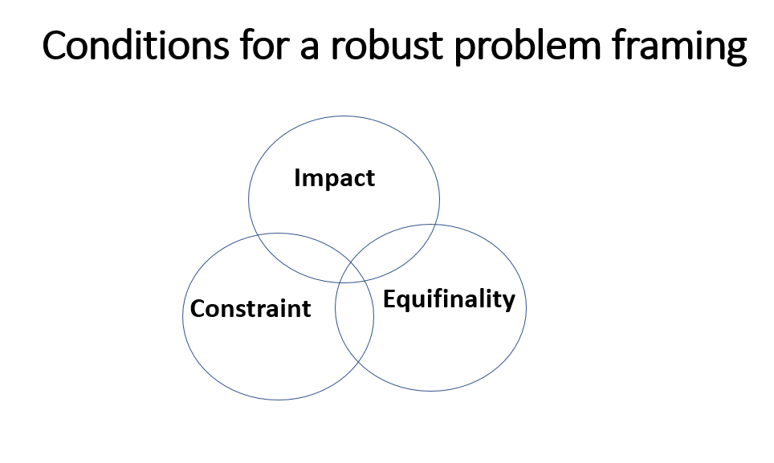

Slide 15
What makes a good problem statement?
A good problem statement is human-centered and user-focused. Based on the insights gathered in the empathize phase, it focuses on the users and their needs—not on product specifications or business outcomes. Here are some pointers that will help to create a meaningful problem statement:
Focus on the user: The user and their needs should be front and center of the problem statement.
Avoid statements that start with “we need to...” or “the product should”, instead concentrating on the user’s perspective: “Young working professionals need...”, as in the examples above.
Keep it broad: A good problem statement leaves room for innovation and creative freedom. It’s important to keep it broad enough to invite a range of different ideas; avoid any references to specific solutions or technical requirements.
Make it manageable: At the same time, problem statement should guide us and provide direction. If it’s too broad in terms of the user’s needs and goals, we will struggle to hone in on a suitable solution. So, don’t try to address too many user needs in one problem statement; prioritize and frame the problem accordingly.

Slide 16
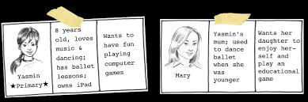
Personas

Slide 17
Personas
A persona is a description of a fictitious user who does not exist as a specific person but described in a way that makes the reader believe that the person could be real.
A Persona is a role or character adopted by an author, actor, etc. or in a game.
Persona is the aspect of someone's character that is presented to or perceived by others.
Personas are detailed descriptions of imaginary people constructed out of well-understood, highly specified data about real people.

Slide 18
Personas
The word Persona comes from Greek which means mask.
When we work with personas, we assume the mask of the users to understand their needs concerning a new product or a service.
Personas are fictional characters, which are created based upon the research in order to represent the different user types that might use our service, product, site, or brand in a similar way.

Slide 19
Importance of Personas
Personas help designers, developers, and stakeholders understand user needs, behaviors, goals, and pain points.
Personas are a powerful tool for making informed decisions about your product or marketing plan by helping you understand your customer's values, pain points, and goals.
Furthermore, a persona makes it possible to get an idea of what the user will use the product for and in what future situation or context it will be used.

Slide 20
Personas
The work with personas is about using the everyday experiences of the users and their needs as a starting point for the development of a product or a service or solve a problem.
The persona method does not include real users but has representations of users.

Slide 21
Applications of Personas in Design Thinking
Product and Service Design: Helps in designing user-friendly interfaces and experiences.
Marketing Strategies: Personas help in crafting targeted messages for different user segments.
UX Research & Testing: Helps in usability testing by ensuring solutions cater to real needs.
Content Strategy: Guides the tone, language, and structure of content.
Customer Support: Improves support processes by anticipating common user issues.

Slide 22
Persona – Example – Designing a Fitness App
Name: Adarsh
Age: 45
Occupation: IT Manager
Tech Comfort Level: Moderate
Goals: Wants to stay fit, reduce stress, and manage weight with minimal time investment.
Pain Points:
Busy schedule, no time for long workouts
Finds tracking fitness data confusing.
Needs motivation to exercise regularly

Slide 23
Persona – Example – Designing a Fitness App
How This Helps Design?
The app should offer quick, effective workouts.
The interface should be simple and intuitive.
It should include reminders and motivational features.

Slide 24
Persona – Example – Designing a Fitness App
Now, introduce a contrasting persona:
Name: Sneha
Age: 22
Occupation: College Student
Goals: Train for a marathon, improve stamina
Pain Points:
Wants advanced workout tracking
Prefers competitive features (leaderboards)
Needs budget-friendly options

Slide 25
Persona – Example – Designing a Fitness App
How This Changes the Design?
The app should have detailed tracking features.
It should include challenges and leaderboards.
It could offer a free or student-discount plan.

Slide 27
Holland's Six Personality Types and Their Influence on Personas
Holland’s RIASEC model classifies people into 6 personality types, which can help define diverse user personas, Understanding these personality types helps create more realistic and relatable personas:
Realistic – “Do-er”- Practical, hands-on users who prefer efficiency and reliability.
Investigative – “Thinker” - Analytical, data-driven users who seek detailed information.
Artistic - “Creator” - Creative, expressive users who value aesthetics and customization.
Social - “Helper” - Community-focused users who prioritize collaboration and trust.
Enterprising – “Persuader” - Goal-oriented users who value efficiency and leadership.
Conventional – “Organizer” - Detail-oriented users who prefer structured, predictable systems.

Slide 28
Four Perspectives on Personas
The four perspectives of personas help create well-rounded and realistic user profiles, ensuring that designs cater to different aspects of user needs.
1. Goal-Directed Personas:
Focus: What users want to accomplish when using the product.
Example: A college student using a ride-sharing app to reach campus affordably and on time.
Design Implication: The app should provide quick booking options, fare estimations, and reliable navigation.

Slide 29
Four Perspectives on Personas
2. Role-Based Personas:
Focus: The user’s role in their environment and how it impacts their interaction with the product.
Example: A teacher using an educational app to simplify grading and track student performance.
Design Implication: The app should include easy-to-use grading tools, student progress tracking, and report generation.

Slide 30
Four Perspectives on Personas
3. Engaging Personas:
Focus: User emotions, behaviors, and motivations.
Example: A fitness enthusiast using a workout app for motivation and habit tracking.
Design Implication: The app should offer progress tracking, gamification elements (badges, rewards), and social sharing options.

Slide 31
Four Perspectives on Personas
4. Fictional Personas:
Focus: Hypothetical user profiles based on assumptions, used in early design stages.
Example: A hypothetical tech-savvy teenager for an app targeting Gen Z users.
Design Implication: The initial prototype will be adjusted later based on real user data and feedback.
Alexa (AI Assistant) started as a fictional persona → Later, it was refined using real user feedback.

Slide 32
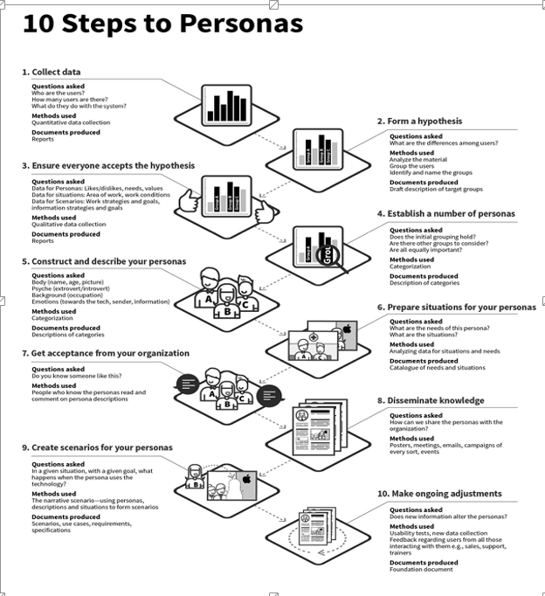
Steps to create Personas

Slide 33
Steps to create Personas
Collect data: Collect as much knowledge about the users as possible. Perform high-quality user research of actual users in the target user group.
In Design Thinking, the research phase is the first phase, also known as
the Empathise phase.
2. Form a hypothesis: Based upon the initial research, form a general idea of the various users within the focus area of the project, including the ways users differ from one another – For instance, we can use Affinity Diagrams and Empathy Maps.
3. Everyone accepts the hypothesis: The goal is to support or reject the first hypothesis about the differences between the users.
We can do this by confronting project participants with the hypothesis and comparing it to existing knowledge.

Slide 34
Steps to create Personas
4. Establish a number: Decide upon the final number of personas, which it makes sense to create.
Most often, we would want to create more than one persona for each product or service, but we should always choose just one persona as our primary focus.
5. Describe the personas: The purpose of working with personas is to be able to develop solutions, products and services based upon the needs and goals of our users. Be sure to describe personas in such a way as to express enough understanding and empathy to understand the users.
a. We should include details about the user’s education, lifestyle, interests, values, goals, needs, limitations, desires, attitudes, and patterns of behavior.
b. Add a few fictional personal details to make the persona a realistic character.
c. Give each of our personas a name.
d. Create 1–2 pages of descriptions for each persona.

Slide 35
Steps to create Personas
6. Prepare situations or scenarios for your personas: This engaging persona method is directed at creating scenarios that describe solutions.
For this purpose, you should describe a number of specific situations that could trigger the use of the product or service you are designing. In other words, situations are the basis of a scenario.
You can give each of your personas life by creating scenarios that feature them in the role of a user.
Scenarios usually start by placing the persona in a specific context with a problem they want to or have to solve.

Slide 36
Steps to create Personas
7. Obtain acceptance from the organization: It is a common thread throughout all 10 steps that the goal of the method is to involve the project participants.
As such, as many team members as possible should participate in the development of the personas, and it is important to obtain the acceptance and recognition of the participants of the various steps.
In order to achieve this, you can choose between two strategies: You can ask the participants for their opinion, or you can let them participate actively in the process.
8. Disseminate knowledge: In order for the participants to use the method, the persona descriptions should be disseminated to all.
It is important to decide early on how you want to disseminate this knowledge to those who have not participated directly in the process, to future new employees, and to possible external partners.
The dissemination of knowledge also includes how the project participants will be given access to the underlying data.

Slide 37
Steps to create Personas
9. Everyone prepares scenarios: Personas have no value in themselves. Until the persona becomes part of a scenario – the story about how the persona uses a future product – it does not have real value.
10. Make ongoing adjustments: The last step is the future life of the persona descriptions.
Revise the descriptions on a regular basis.
New information and new aspects may affect the descriptions.
Sometimes we would need to rewrite the existing persona descriptions, add new personas, or eliminate outdated personas.

